Slide 1
Chapter No.4 Secondary Storage Devices

Slide 2
Solid State Storage Devices

Slide 3
Solid State storage Devices
There are three primary types of storage technology. These are state-of - the-art mechanical, electrical and solid technologies. Solid state devices include USB flash drives, SD cards, micro SD cards, newer types of hard drives, SIM cards on your cell phone, and smart cards such as chip and pin credit and debit cards. Solid state devices store data in binary patterns using billions of tiny low voltage switches called transistors. If the switch is open, this reflects a binary one as the transistor holds its charge-the charge cannot be discharged. If it's closed, it's a binary zero because the charge has a path to escape.

Slide 4
Potable/Mobile Storage Devices
Computers used to fill the space. Nowadays, tiny disks hold more data than early computers. Within the computing world, portable storage devices include flash drives, external hard drives (sometimes called micro hard drives) and portable CD / DVD-ROM drives.

Slide 5
USB Flash Drive
The USB flash drive is a data storage system that includes a flash memory and an integrated Universal Serial Bus (USB) interface.
Physically, they're thin, sturdy and efficient. The greater their storage space, the quicker they continue to run.
Some of the USB flash drives are removable and rewritable. Mechanically, USB flash drives are very durable since there are no moving parts.
They derive the power to operate from the system to which they are attached (usually a computer) through the USB port.
This is a regular USB plug. This allows the flash drive to be linked to the computer.

Slide 6
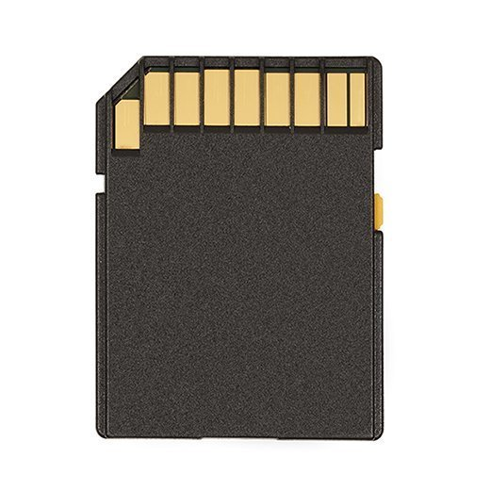
Flash Memory Card
A flash memory card sometimes called a SD card is a compact storage unit that uses non-volatile semiconductor memory to store data on portable or remote computer devices. Such data includes text, photographs, audio and video. Most current products use flash memory, although other memory technologies are being developed, including devices that combine dynamic random access memory (DRAM) with flash memory.

